Slide 1
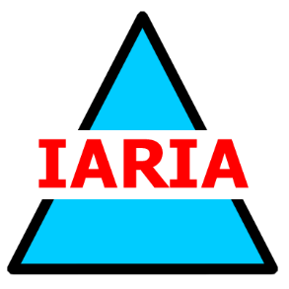
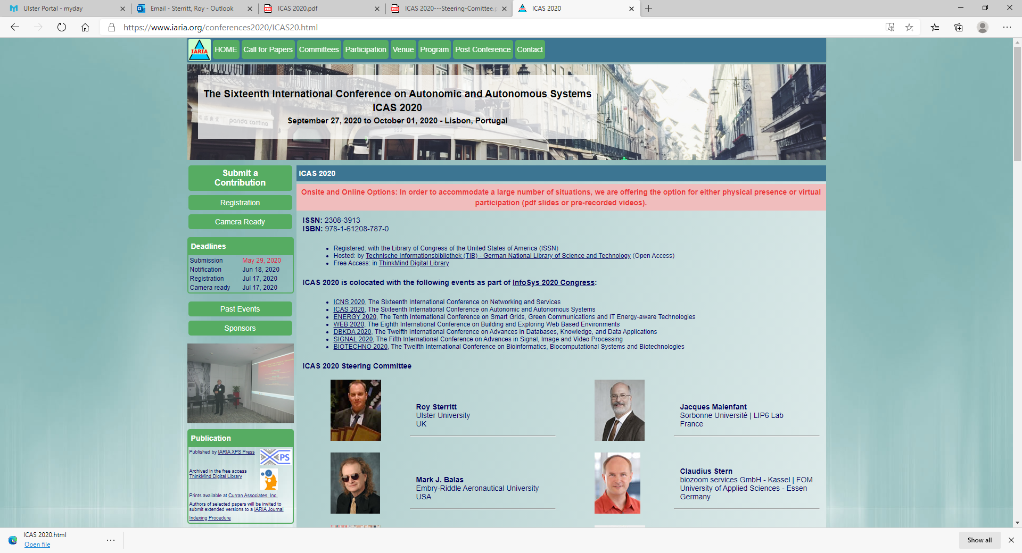
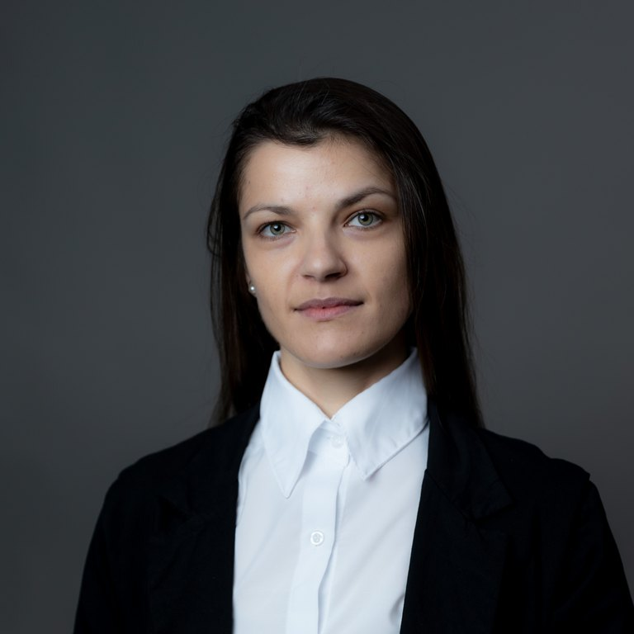
Open Discussion
Creativity and Creativeness in the Digital & AI Era
NICE
July 2026
In the AI era, creativity is being redefined rather than replaced: AI is a co-creator, but ownership, authenticity and accountability must remain human.
  Augmentation, not authorship — AI widens who can create and how fast, yet intent, judgment and responsibility stay human. Where is the line between assisted and generated?
  One toolkit, two faces — the same generative models that expand artistic expression also industrialize deepfakes, disinformation and propaganda. Creation and manipulation now share one engine.
  Trust, authenticity and provenance — as synthetic media becomes indistinguishable from the authentic, audiences need new signals: provenance, watermarking, media literacy and fact-checking.
  Whose creativity? — models create from other people’s work. Attribution, copyright, bias and fairness in training data remain unresolved.
  To debate — Does generative AI democratize creativity or homogenize it? Should AI-made media be labeled by default? Who is accountable when creative AI is weaponized for propaganda?
Cristiane Melchior
Postdoctoral researcher
LUT University, Finland

